Slide 2







Marco Pozzan
Consulente e formatore in ambito business intelligence
Nel 2020 Fondatore e CTO start-up per analisi dati e per insurance data analytics per le compagnie assicurative Dal 2017 mi occupo di architetture big Data e in generale di tutta la proposizione data platform di Microsoft.
Docente all'Università di Pordenone per i corsi IFTS di analisi Big Data
Community Lead di 1nn0va (www.innovazionefvg.net)
MCP,MCSA,MCSE dal 2017 MCT e dal 2014 MVP per SQL Server e relatore in diverse conferenze sul tema.
marco.pozzan@regolofarm.com
@marcopozzan.it
www.marcopozzan.it
http://www.scoop.it/u/marco-pozzan
http://paper.li/marcopozzan/1422524394

Slide 3
section
Data Warehouse with Fabric on data lakehouse

Slide 4
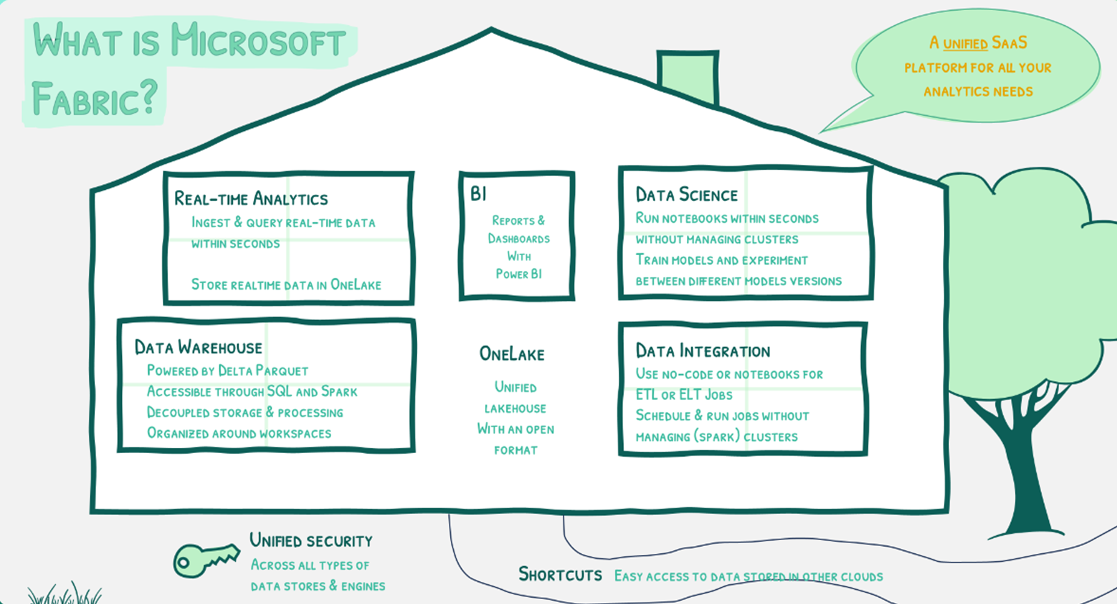

Slide 5
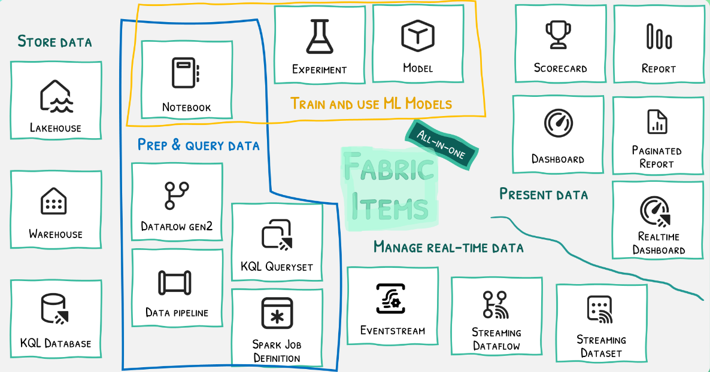

Slide 6
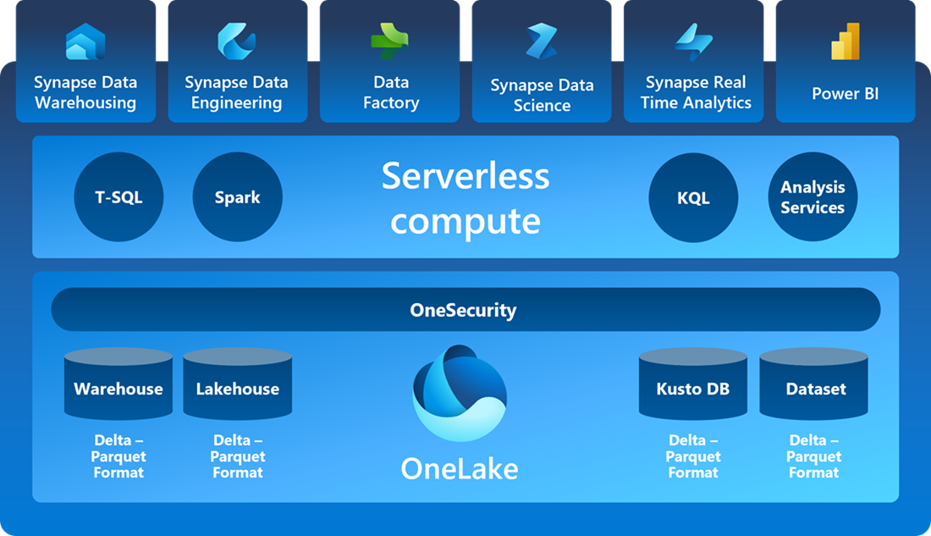

Slide 7
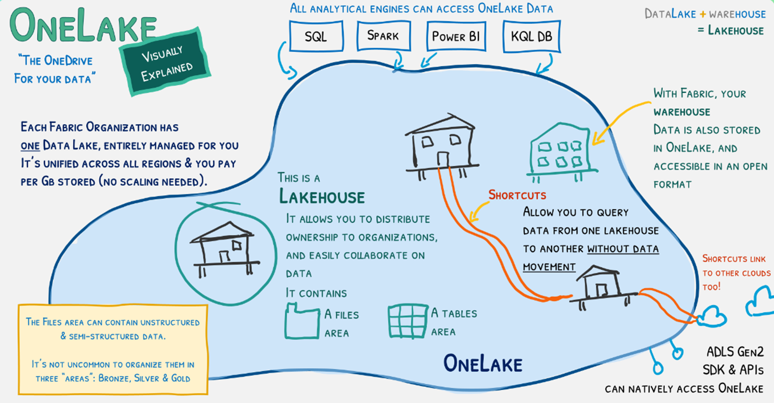

Slide 8
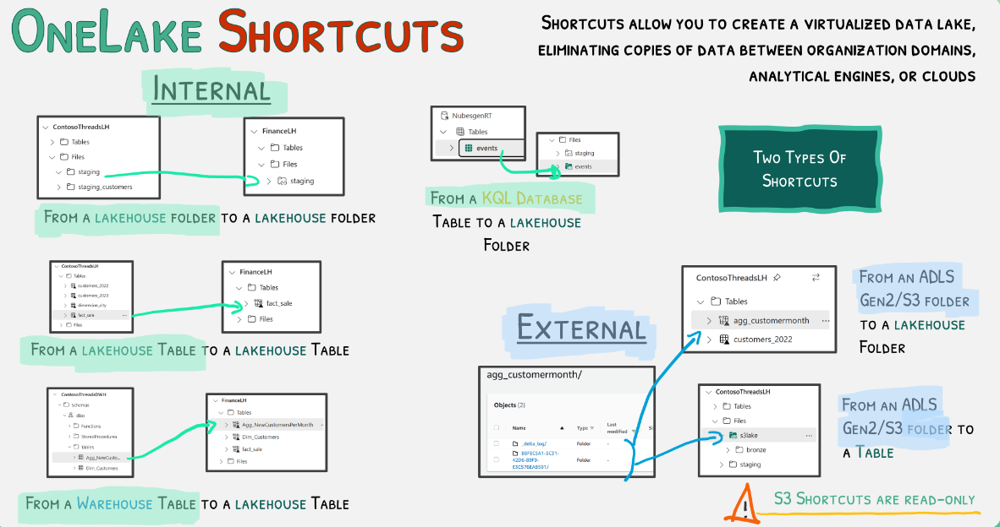

Slide 9
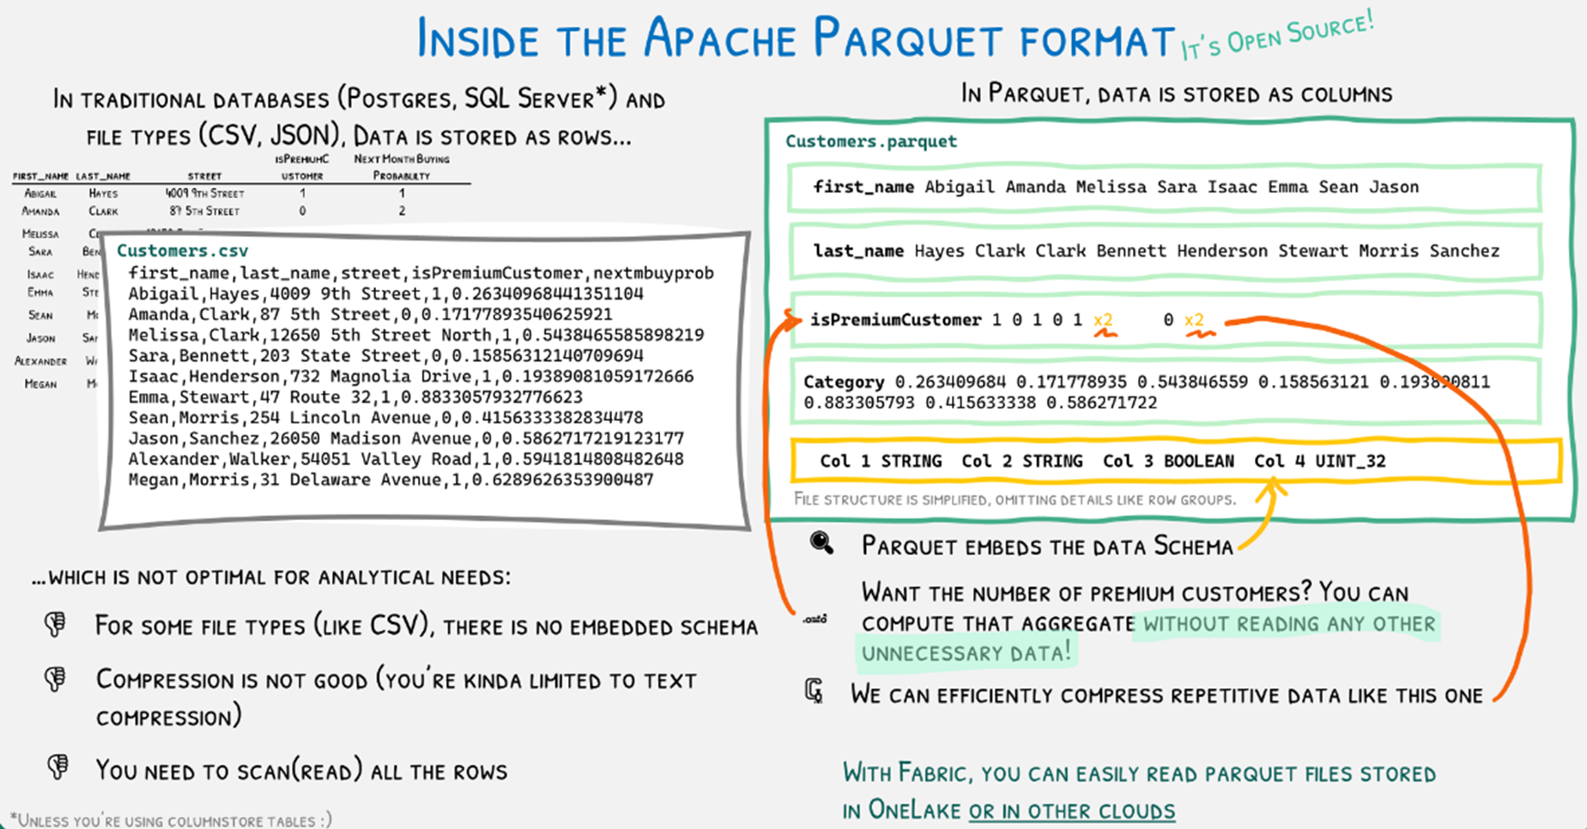

Slide 10
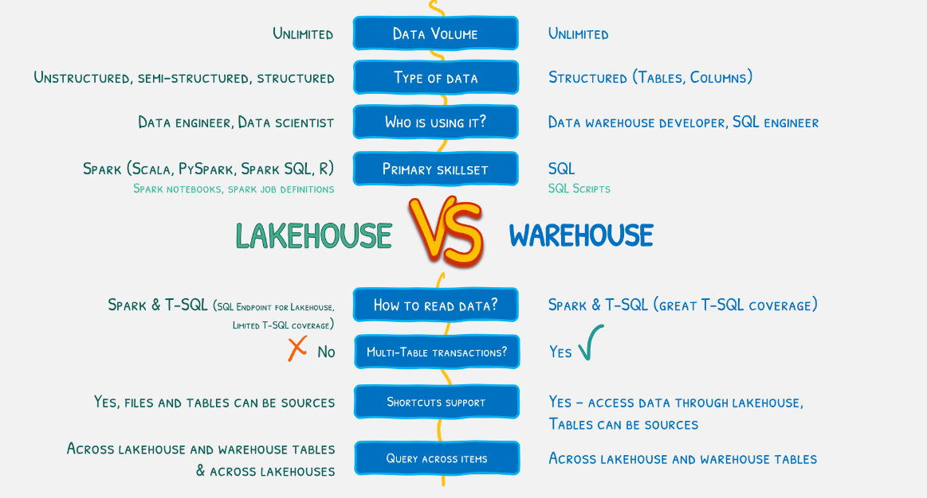

Slide 11
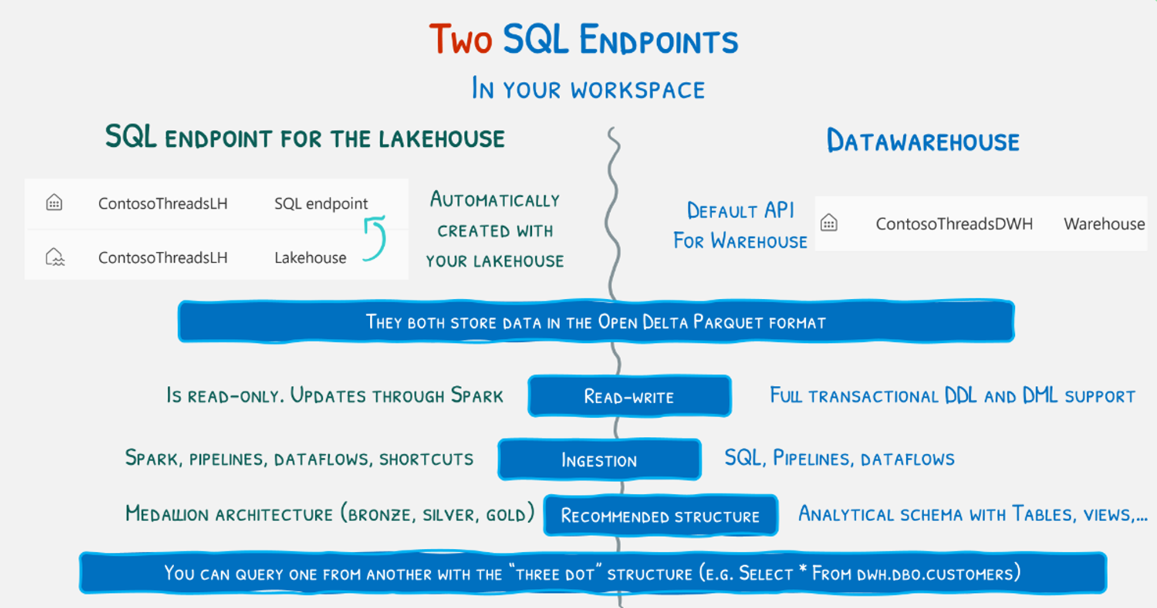

Slide 12
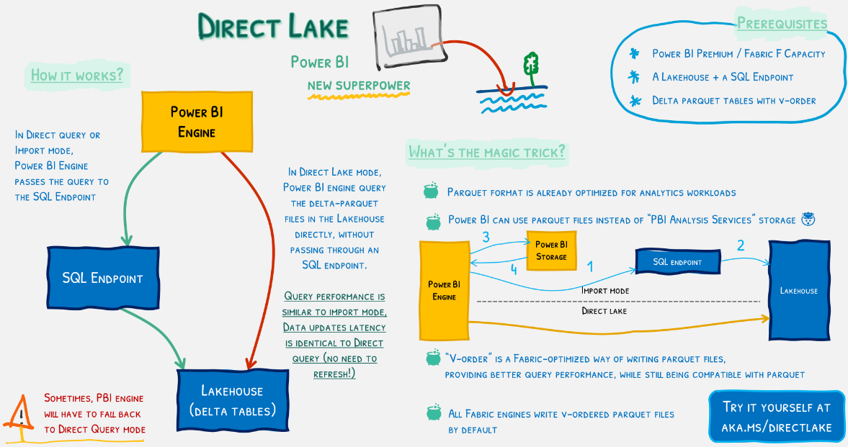

Slide 13
Medallion Architecture
Databricks recommends taking a layered approach to creating a single source of truth for enterprise data products.
This architecture ensures atomicity, consistency, isolation, and durability as data passes through multiple levels of validations and transformations before being stored in a layout optimized for efficient analysis.
It is important to note that this medallion architecture is not a substitute for other dimensional modeling techniques.The schemas and tables within each tier can take a variety of forms and degrees of normalization depending on the frequency and nature of data updates and downstream use cases for the data.

Slide 14
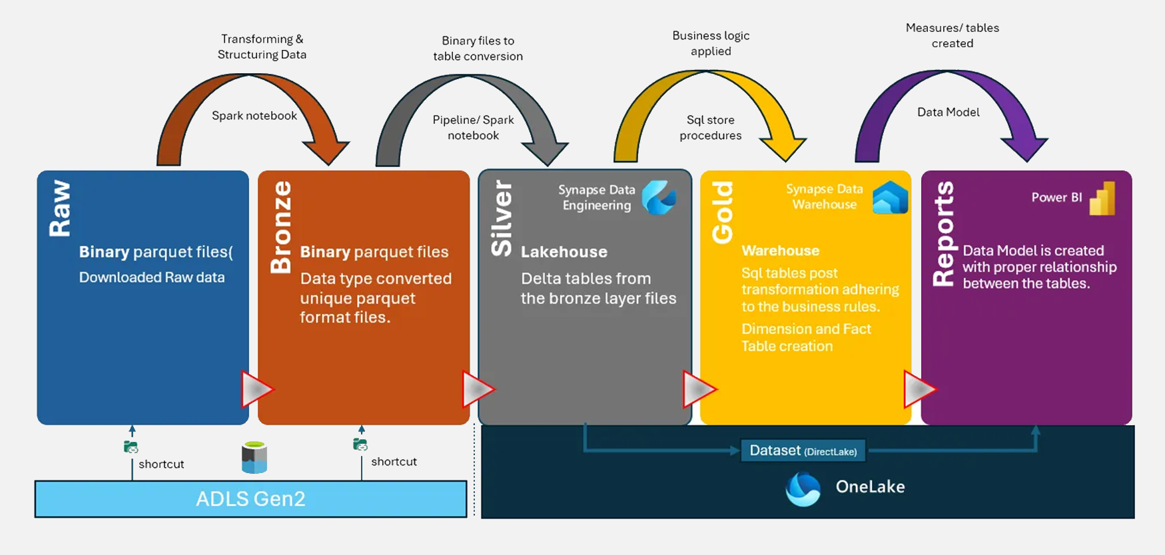
Medallion Architecture
I termini bronzo (grezzo), argento (convalidato) e oro (arricchito) descrivono la qualità dei dati in ciascuno di questi livelli.

Slide 15
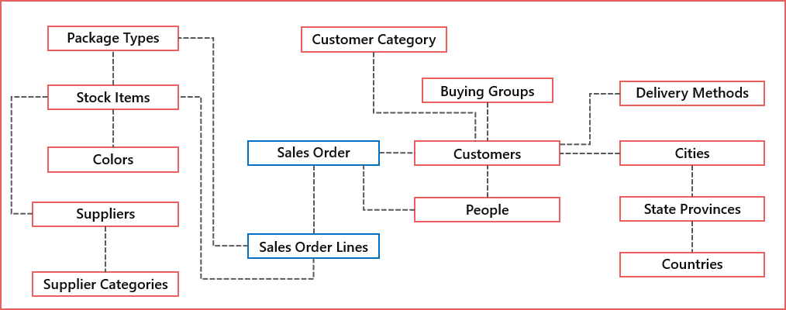
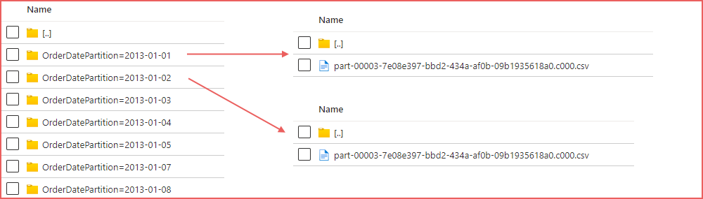
Demo

Slide 16
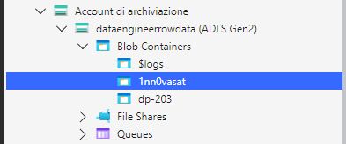
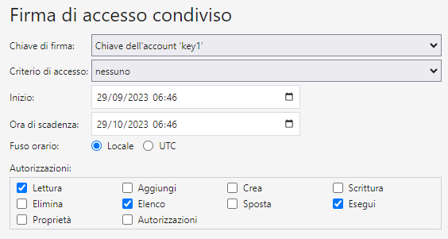
Demo – token SAS generation
?sv=2020-02-10&st=2023-09-29T04%3A46%3A14Z&se=2023-10-29T05%3A46%3A00Z&sr=c&sp=rle&sig=uds%2BXKBHBBkelOkOFjeOblWlxQ5vPWBk0unBtysXgeY%3D

Slide 17
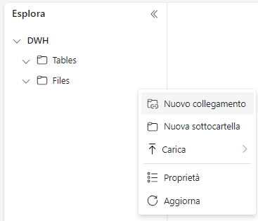
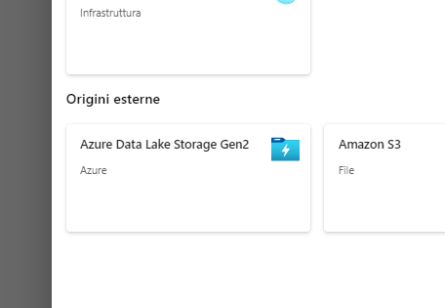
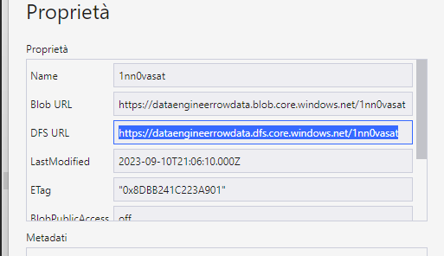
Demo – Shortcut configuration for bronze layer (part 1)
https://dataengineerrowdata.dfs.core.windows.net/1nn0vasat

Slide 18
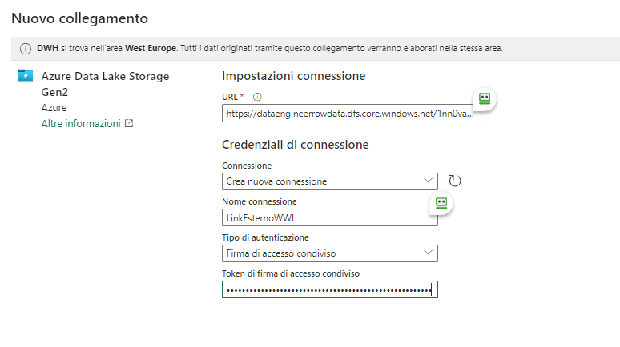
Demo – Shortcut configuration for bronze layer (part 2)
https://dataengineerrowdata.dfs.core.windows.net/1nn0vasat
LinkEsternoWWI

Slide 19
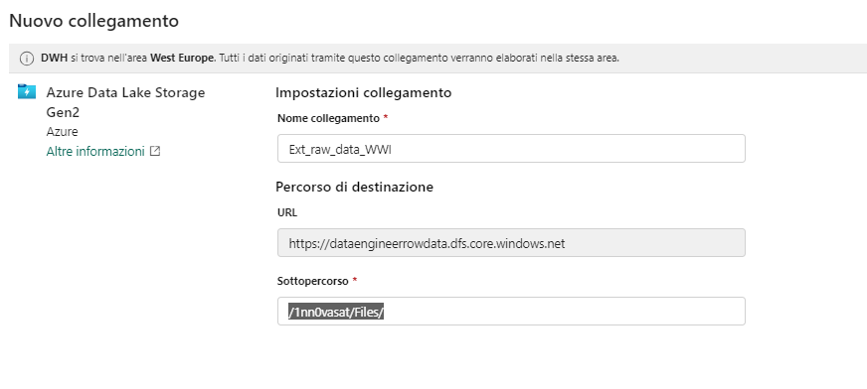
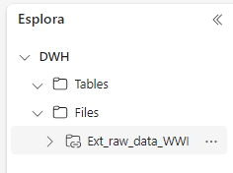
Demo – Shortcut configuration for bronze layer (part 3)
Ext_raw_data_WWI
/1nn0vasat/Files/

Slide 20
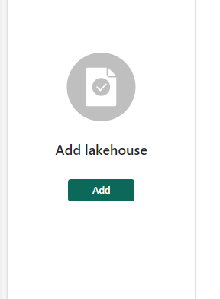
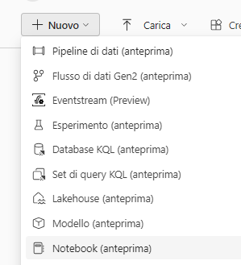
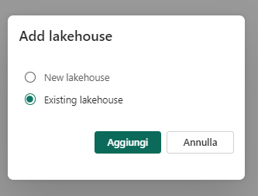
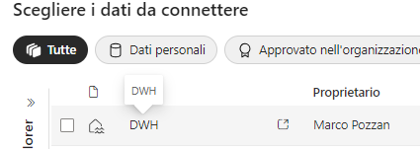
Demo – Load silver layer with Notebook

Slide 21
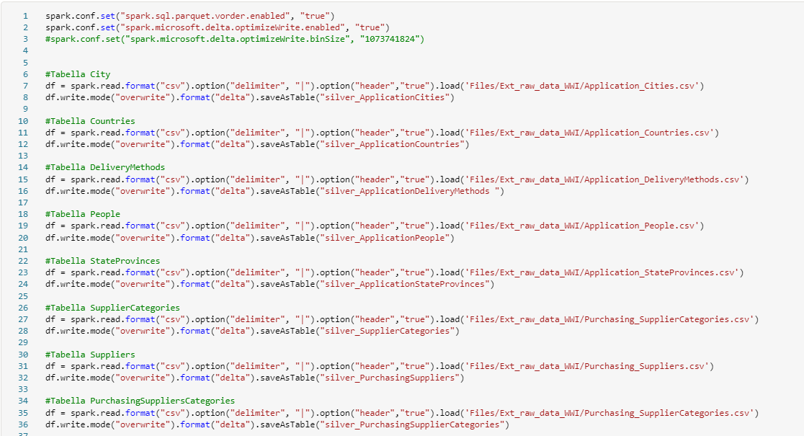
Demo – Load silver layer with Notebook

Slide 22
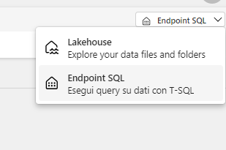
Demo – Test table
SELECT YEAR(SO.OrderDate) AS OrderDateYear,
COUNT(SO.OrderDate) AS TotalOrderCount
FROM [DWH].[dbo].[silver_salesorder] SO
GROUP BY YEAR(SO.OrderDate);
SELECT ISNULL(C.ColorName,'No Colour') AS ColourName,
SUM(cast(SOL.Quantity as int)) AS TotalOrderLineQuantity,
SUM(cast(SOL.UnitPrice as numeric)) AS TotalOrderLineUnitPrice
FROM [DWH].[dbo].[silver_salesorderline] SOL
INNER JOIN [DWH].[dbo].[silver_stockitems] SI ON SI.StockItemID = SOL.StockItemID
LEFT JOIN [DWH].[dbo].[silver_colors] C ON C.ColorID = SI.ColorID
GROUP BY ISNULL(C.ColorName,'No Colour’);
SELECT
YEAR(SO.OrderDate) AS OrderDateYear,
SC.SupplierCategoryName,
SUM(cast(SOL.Quantity as int)) AS TotalOrderLineQuantity,
SUM(cast(SOL.UnitPrice as numeric)) AS TotalOrderLineUnitPrice
FROM [DWH].[dbo].[silver_salesorderline] SOL
INNER JOIN [DWH].[dbo].[silver_salesorder] SO ON SO.OrderID = SOL.OrderID
INNER JOIN [DWH].[dbo].[silver_stockitems] SI ON SI.StockItemID = SOL.StockItemID
INNER JOIN [DWH].[dbo].[silver_suppliers] S ON SI.SupplierID = S.SupplierID
INNER JOIN [DWH].[dbo].[silver_categories] SC ON SC.SupplierCategoryID = S.SupplierCategoryID
GROUP BY YEAR(SO.OrderDate),
SC.SupplierCategoryName;

Slide 23
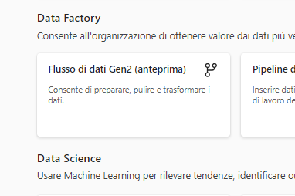
Demo – Load silver layer with DataFlow (Part 1)

Slide 24
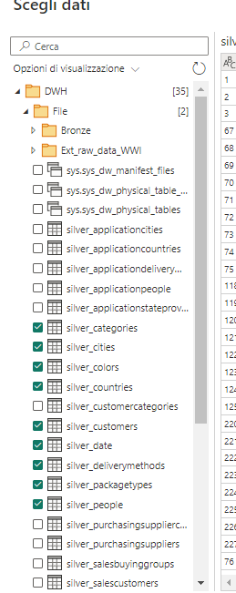
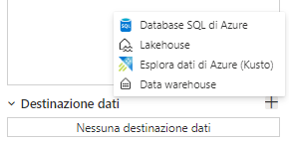
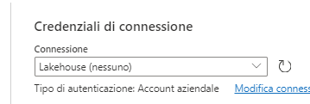
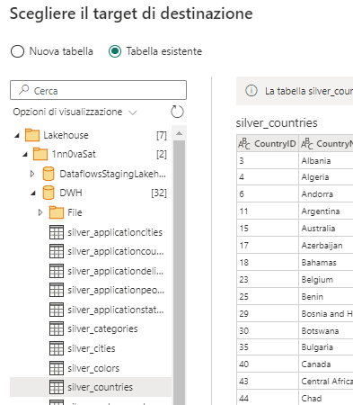
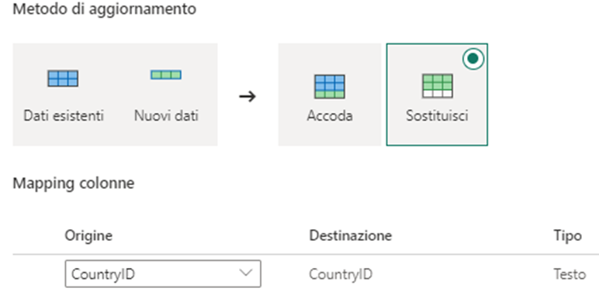
Demo – Load silver layer with DataFlow (Part 1)
For each table i can set sink into deltalake

Slide 25
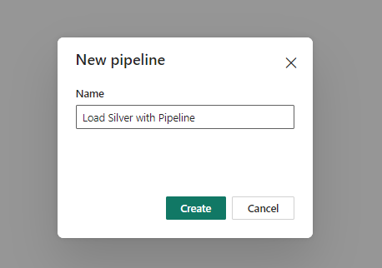
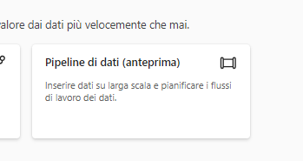
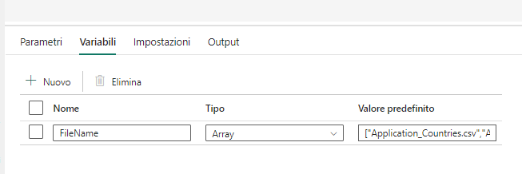
Demo – Load silver layer with Pipeline (Part 1 define variables)
Set variables with this array
["Countries","DeliveryMethods","People","StateProvinces","SupplierCategories","Suppliers","BuyingGroups","CustomerCategories","Customers","Colors","PackageTypes","StockItems","Cities","Date"]

Slide 26
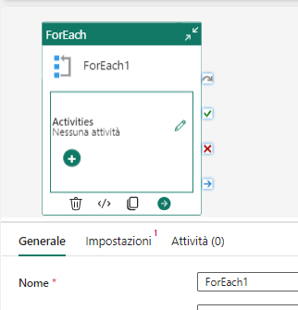
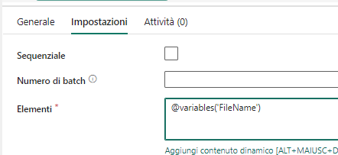
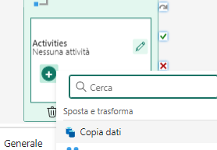
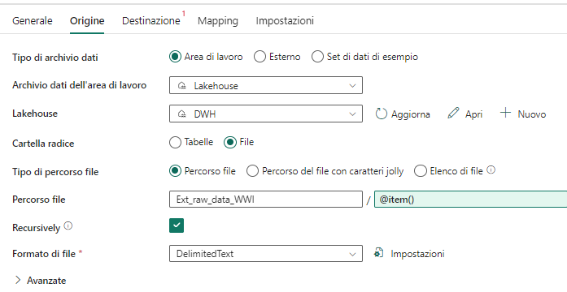
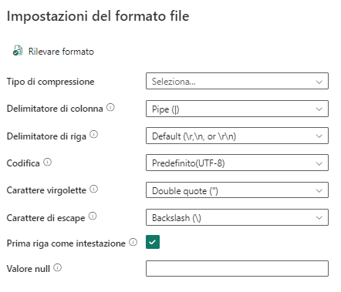
Demo – Load silver layer with Pipeline (Part 2 copy activity source)
@variables('FileName')
@concat(item(),'.csv')

Slide 27
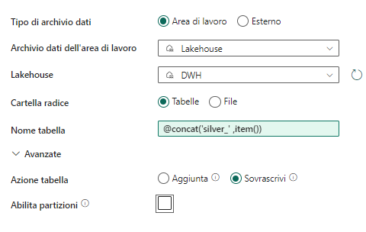
Demo – Load silver layer with Pipeline (Part 3 copy activity sink)
@concat('silver_' ,item())

Slide 28
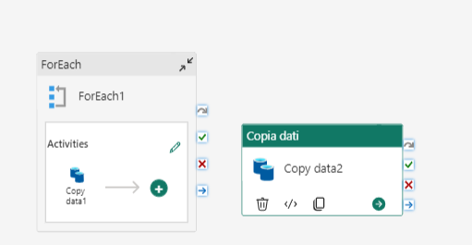
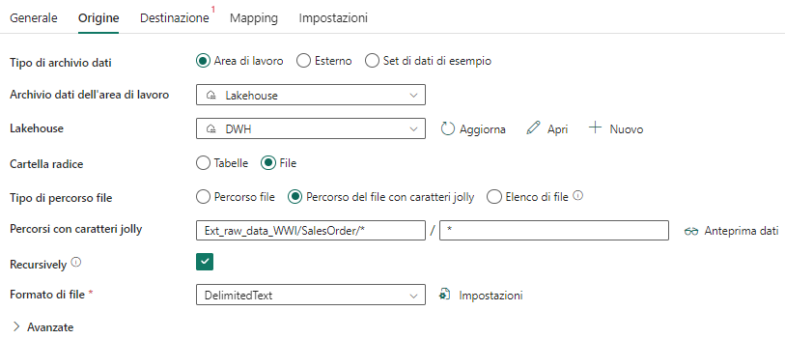
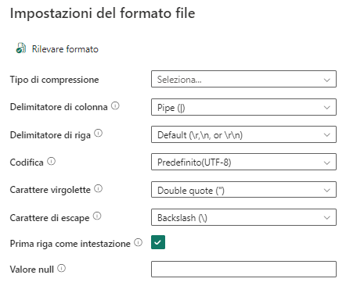
Demo – Load silver layer with Pipeline (Part 4 copy activity source)
Ext_raw_data_WWI/SalesOrder/*

Slide 29
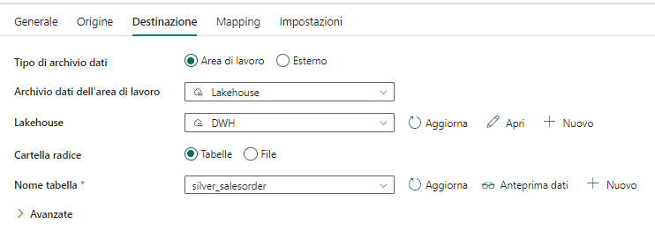
Demo – Load silver layer with Pipeline (Part 5 copy activity sink)

Slide 30
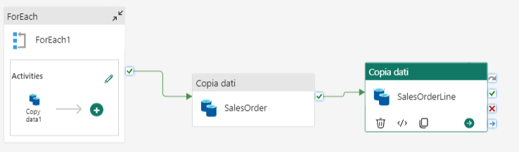
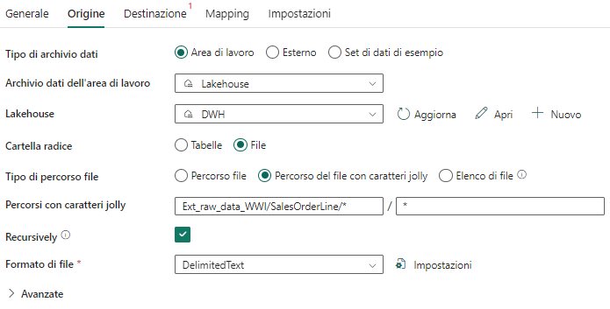
Demo – Load silver layer with Pipeline (Part 6 copy activity source)
Ext_raw_data_WWI/SalesOrderLine/*

Slide 31
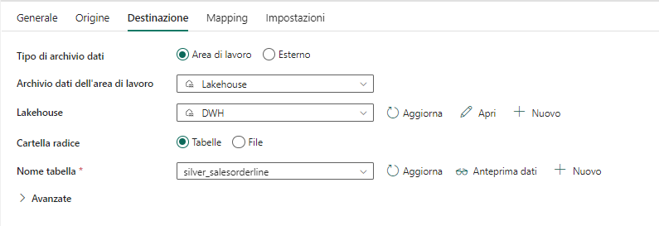
Demo – Load silver layer with Pipeline (Part 7 copy activity sink)

Slide 32
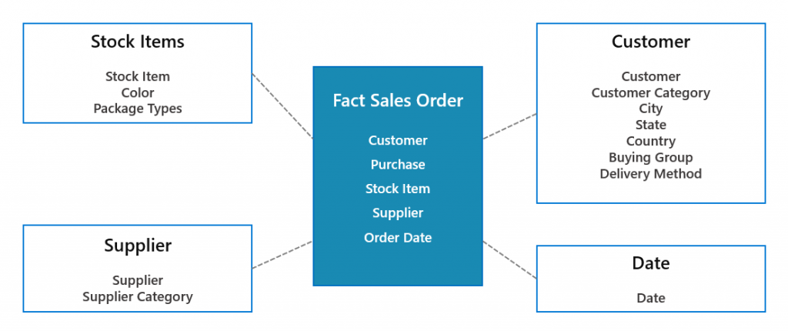
Demo – Load gold layer with sql queries

Slide 33
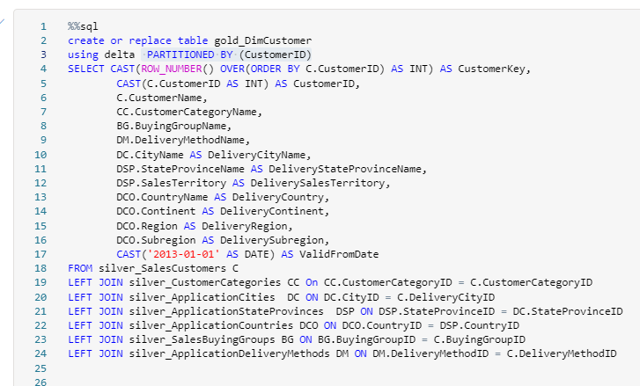



Demo – Load gold layer with sql queries

Slide 34



Demo – Create Serving Layer

Slide 35


You only pay what goes beyond the limit that is provided by default for OneLake (1TB)
You only pay what goes beyond the limit that is provided by default for OneLake (1TB)

Slide 36


Slide 37



Pay as you Go:
Microsoft Fabric has two declinations, one as a pay-as-you-go service within Azure.
With the Power BI P1 SKU you have the equivalent of the Fabric F64 SKU as seen in the table below
The CU (Capacity Units) are used to measure the computing power available for each SKU while for Power BI SKU we still think about V-Cores
Reserved Instance
Corresponds to Power BI Premium Capacity

Slide 38


Power BI Premium Capacity
Power BI Premium Capacity provide all the features of Fabric
Recall that Microsoft Fabric (reserverd Instance) is the same thing as Premium capacity but it is different ☺ as they are different only where you buy one through Microsoft 365 and the other from the Azure portal

Slide 39



Power BI Embedded
Power BI Embedded can always be purchased through the Azure portal
It includes only one A SKU and therefore only Power BI features and not Fabric features
For each A SKU there are equivalent licenses in Fabric as shown in the table below to purchase

Slide 40



Power BI Fabric
Power BI Fabric replaces the old Power BI Free license
It has no trial period
A user with a free license can consume contents if the respective workspaces are created in a Fabric F64 or in Power BI P1 SKU (all the colored part in the table)

Slide 41


Power BI Pro
Power BI Pro is the same as before and does not include Fabric features
Power BI functionality within a Fabric workspace requires a Power BI Pro license
A user needs a Power BI Pro license if their workspaces are created in a Fabric lower than F64 or anything lower than Power BI P1 SKU (all colored part in the table)

Slide 42


Power BI Premium per User
Power BI Premium per user offers features similar to Premium Capacity with partial access to Fabric (you can see it from the graphics) obviously at a lower cost of $20 per user
Ideal for small companies or small work teams

Slide 43

Power BI Premium Governament
This remains the same for US Government customers and will be released after Fabric general availability

